Slide 1


Nutrition Dialogues
Online Children’s Workshop
Objectives
Encourage the active participation of children and young people in a child-friendly conversation to share perceptions, ideas and potential actions to improve children’s nutrition in the community.
Support children and young people to build a shared purpose about what they want to achieve on nutrition in the coming years.

Slide 2

Online Safety Tips for Children and Young People
Always share your views in a kind and respectful way.
Never share views that bully or make others feel bad about themselves.
Do not share personal information such as phone numbers and full names.
Do not engage online via private messaging during the Workshop with people you do not know.
Do not add people from the webinar as friends on your personal accounts if you do not know them.
Always report cases of aggressive behaviour, misinformation, or other types of conflict in online chats.

Slide 3

Introducing Ourselves

Slide 4
Online Children’s Workshop
What do we mean by nutrition?

Slide 5
Key Terms & Facts
Nutrition is the intake of food, considered in relation to the body's dietary needs. Adequate food is vital in keeping people alive. Good nutrition is essential to good health.
30 percent of our planet’s population do not have consistent access to nutritious, safe, and sufficient food.
Malnutrition is when children and young people do not have the right amount of energy and/or nutrients due to poor diet or poor care (e.g. sickness, diarrhoea, lack nutritious foods, and proper care).
20 percent of children under five years of age are too short for their age, 7 percent are too thin, and 6 percent are overweight.

Slide 6
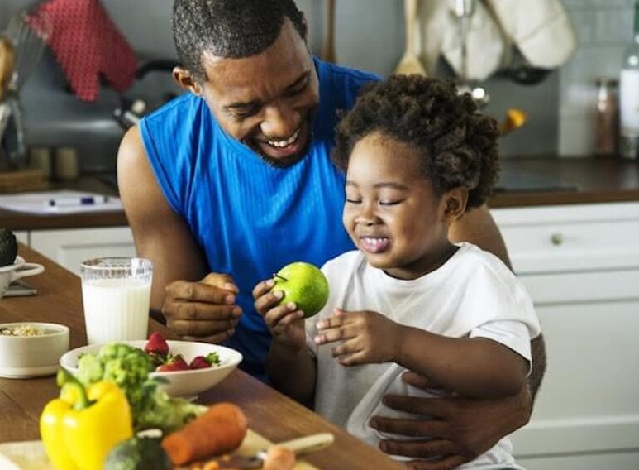

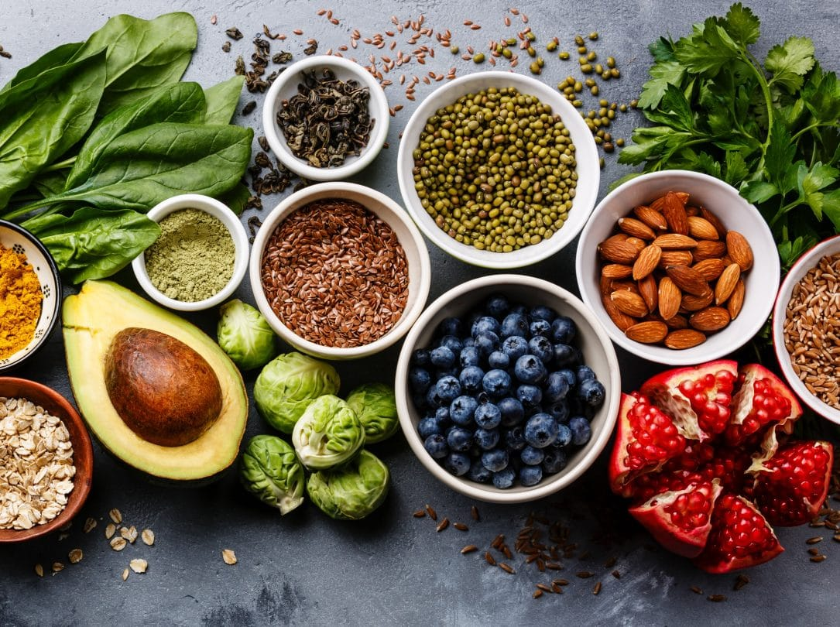

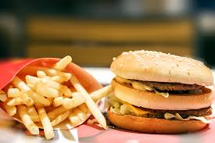

What is your understanding of good nourishment?
1
2
3
1
4
5
6

Slide 7
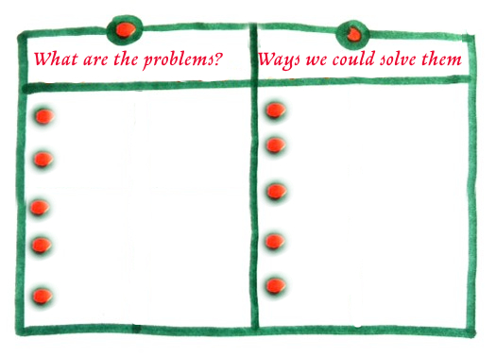
Your ideas to improve nourishment

