Slide 1
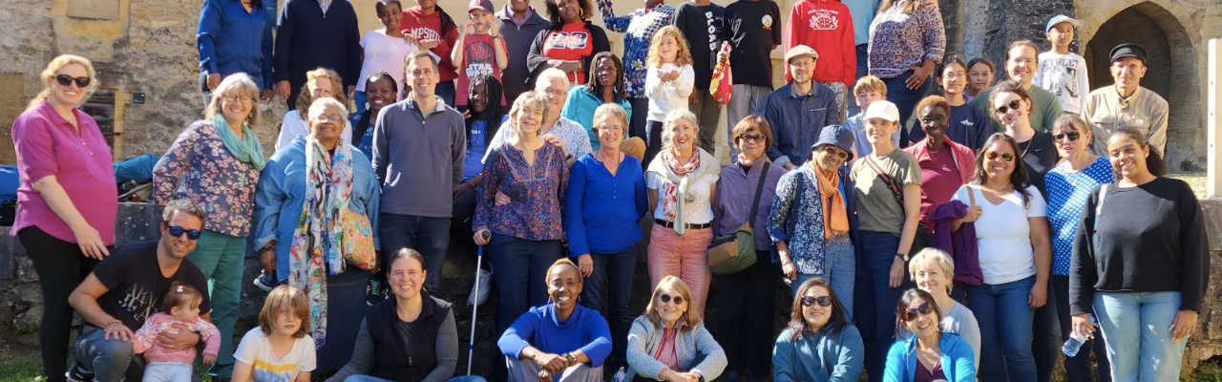

Our efforts to help alleviate hunger in Geneva

Slide 2
Geneva
2020: 2,8 million meals distributed
2021: 12 000 people profited from food distribution
2022: distribution of 3,5 millions meals
2022: more than 14 000 people profited from food distribution
…so the numbers are rising
February 2023: more than 23 000 shopping bags with basic needs distributed
Source: https://ssp-vpod.ch/nous-rejoindre/adhesion/service/journal-services-publics/la-suisse-existe-par-jean-ziegler/la-faim-a-geneve/

Slide 3

Carrefour-Rue &
La Coulou
support for people in social difficulties or in situations of inadequate housing / homelessness
a place of comfort and rest
hot meal, health care, personal hygiene
clothing
Shelters
Point d’eau (Water source)
Cremaillere du Thé-Flon
Car Touche
Jardin de Montbrillant

Slide 4
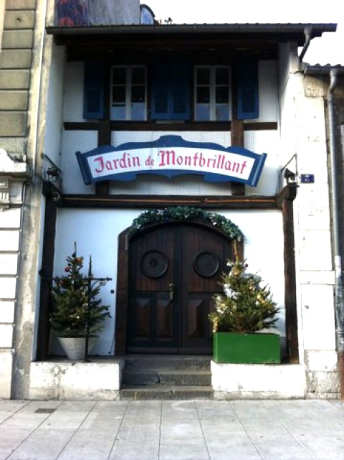
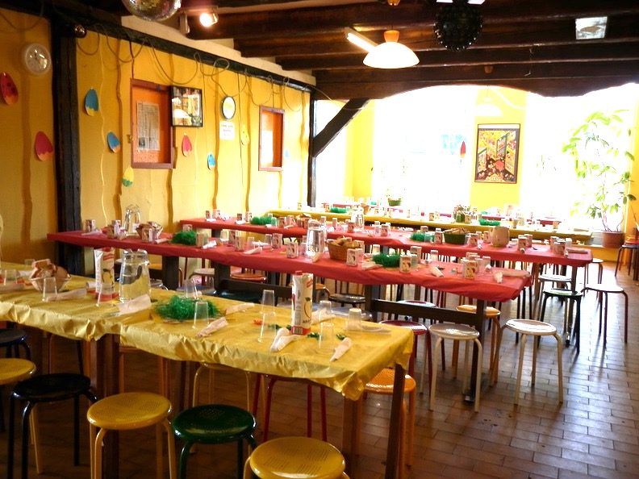
ELCG and Jardin de Montbrillant
Late 90’s: ELCG approaches the La Coulou
Prepares 1 meal/month i.e. 60 meals
COVID19 pandemic: Distribution of 200 sandwiches/week

Slide 5
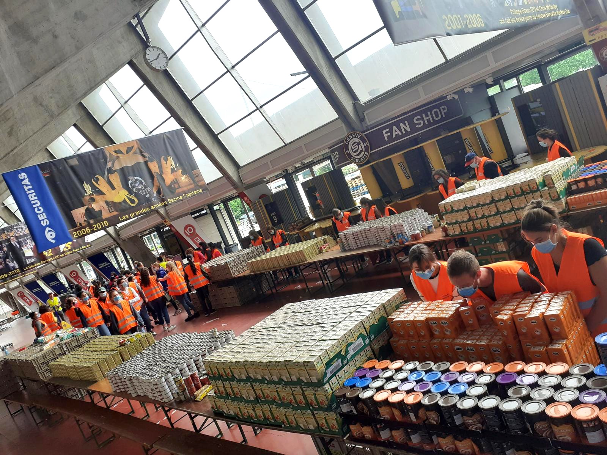
COVID19 pandemic - 2020
Caravane de solidarité (2020)
Les Vernets Ice hockey stadium
April to June: Every Saturday
Queue: 1 km, 4 hours in line

Slide 6
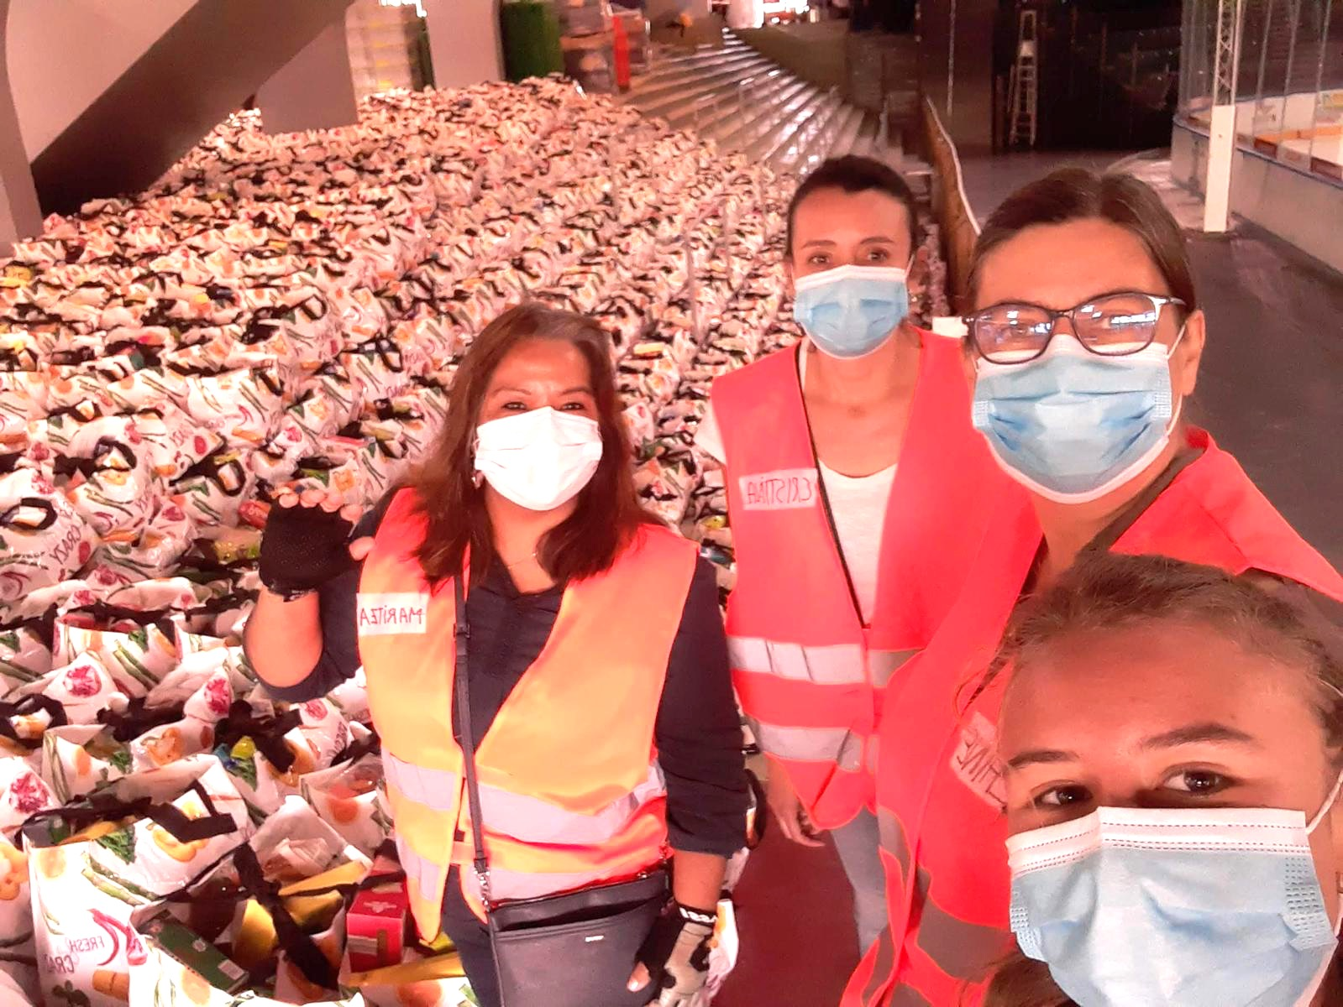
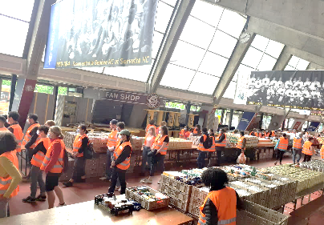
16,127
Amount of food parcels distributed between April / June 2020
Notes:
16,127 Parcels were given between April / June

Slide 7
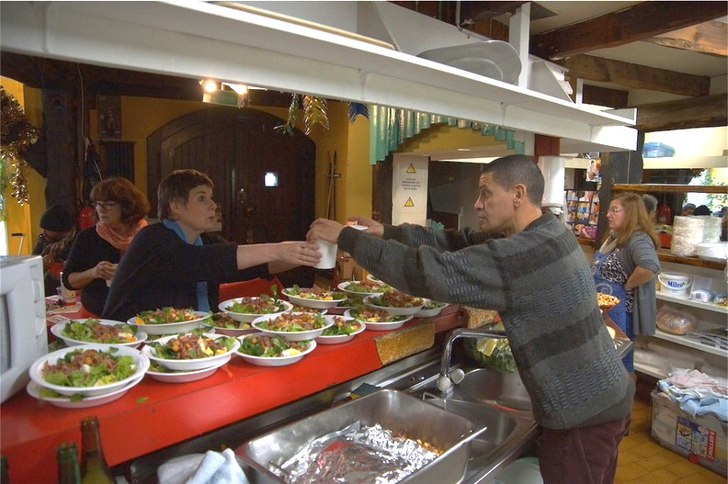
Jardin de Montbrillant
7 Saturdays/year
13-15 volunteers
220-260 meals

Slide 8
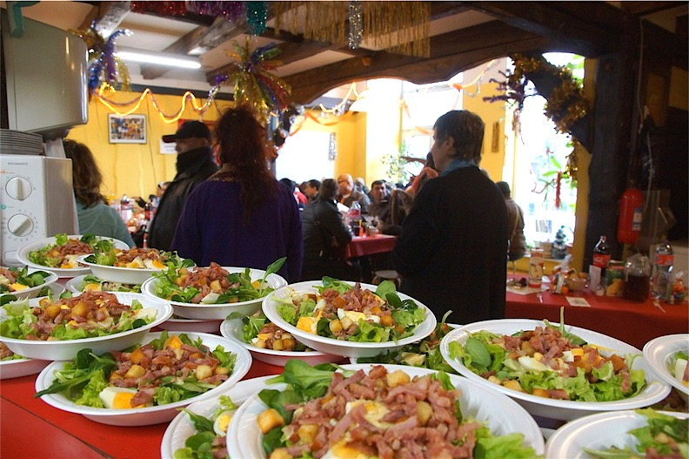
Jardin de Montbrillant
Hospitality – 300 meals/day
Accommodation – 18,000 nights/year

